Slide 1
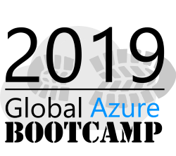

Marco de
Gobierno Cloud
Juan Pablo Tasayco
Cloud Service Manager
https://www.linkedin.com/in/juan-pablo-tasayco-94251967/

Slide 2
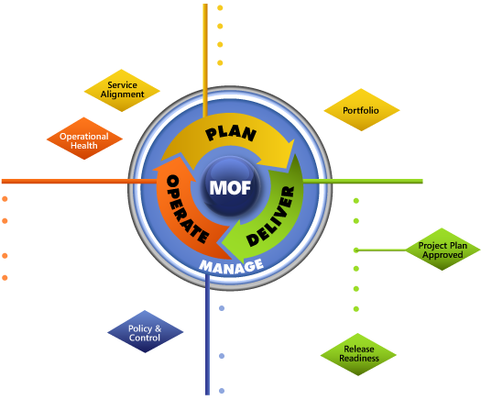
RACI - Reference Models used
Processes
Roles
Based on the Cloud Services Foundation Reference Model
Based on the TEAM SMF of the Microsoft Operations Framework www.microsoft.com/mof

Slide 3
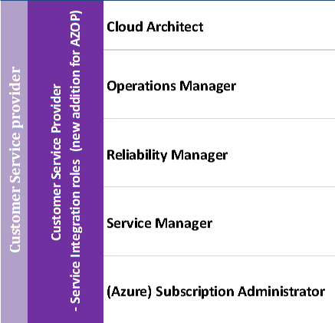
Service Integration – Azure Accountabilities (Source RACI)
Roles
Processes
Business Relationship Mgmt
Capacity Management
Availability & Continuity Management
Information Security Management
Regulatory Policy & Compliance Mgmt
Financial Management
Service Level Management
Service Lifecycle Management
Request Fulfillment
Access Management
Asset & Configuration Management
Release & Deployment Management
Incident & Problem Management
*Accountability for Service Lifecycle, Asset & Configuration Management regarding VM’s and VM Templates are in scope of Service Consumer/Service Provider/Cloud Provider

Slide 4
Redefining IT’s role for a cloud future
Service Provider - Service Management
Provide standardized self-service interface(s), standardized service(s) and process(es)
Provide automated deployment of service(s) and execution of process(es)
Manage incident(s) occurring in standardized service(s) and process(es)
Manage problem(s) resulting from re-occurring incident(s) in standardized service(s) and process(es) and perform root cause analysis
Provide monitoring and reporting data (e.g. performance data) on standardized service(s) and process(es)
Service (Mgmt) Integration
SLA
Service Consumer
SLA
SLA
SLA
SLA
SLA
SLA
OLA
Service Consumer
Service Consumer
SLA
OLA
Platform (Mgmt) Mgmt Integration
SLA
OLA
Service (Management) Provider - Service Integration
Define and maintain operating level agreement(s) per service provider
Define and maintain service level agreement(s) per customer
Manage service provider(s) as defined in the operating level agreement(s)
Manage service(s) as defined in the service level agreement(s)
Provide service level agreement reporting (incident, problem, change etc..)
SLA
OLA
IAAS
PAAS
SAAS
IAAS
PAAS
SAAS
Public Cloud
Private Cloud
Service Provider - Platform Management Integration
Provide E2E self-service interface(s)
Provide the capability for E2E deployment of standardized services
Provide the capability for E2E execution of automated process(es)
Provide E2E integration of service management tooling and interfaces
Customer
Notes:
Speaker Notes:
- Shared services requires an organization structure change where skills shift so that services can be defined from quality attributes instead of technical features

Slide 5

Cloud Services Foundation Reference Model

Slide 6

Reference Model as Starting Point
The predefined roles and processes are based on the Cloud Services Reference Model
Predefined Processes
Service Delivery
Service Manager
Reliability Manager
Architect
New Environment
Capabilities
Predefined Processes
Application
Management & Support
Service Operations
Developer
Tester
Operator
Mgmt & Sup Administrator
Operations Manager
Platform
Platform Administrator
Author
Fabric
Fabric Administrator
Notes:
Speaker notes:
The cloud service foundation reference model describing the best practices which Microsoft uses to define, build and operate an cloud solution, whether this is a IaaS, PaaS or SaaS solution. The reference model is publicly available using the link on the slide. The model consists of three parts:
The cloud solution itself separated by the infrastructure / Platform and Software defining the IaaS, PaaS and SaaS layers.
Management and support provide all the capabilities that are required to manage and support the cloud solution.
In order to delivery and operate the cloud solution properly all processes in green need to be in place as well. The processes are divided into service delivery; what is required to deliver the different cloud service towards the consumer, and service operations; what processes are required to operate the cloud solution end-to-end.
This reference model will be the starting point of the Datacenter Operations workshop.

Slide 7
Tablero de control de Gobierno en la Nube
Inventario
Capacidades
Operaciones
Finanzas
Discovery
Dashboard de consumos
Dashboard de operación
Costos
Tagging
Catálogos
Monitoreo & alertas
Analítica y reportes
Búsquedas
Control de versiones
Automatización
Previsión y Presupuesto
CMDB
Políticas
Lineamientos
Eficiencia
PCI
Identidad y accesos
Gestión de claves
Registros de auditorias
Seguridad

Slide 8
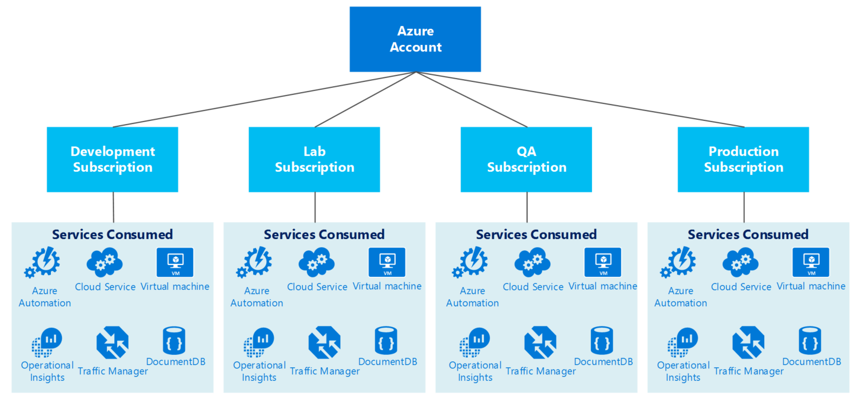
Subscription per environment in the development process of an application. (Example)
Notes:
Some more examples of how the Azure governance can be set up

Slide 9
Role Based Access Control
SUBSCRIPTION
Allows secure access with granular permissions to resources
Assignable to users, groups or service principals
Built-in roles make it easy to get started
RESOURCE GROUP
RESOURCE

Slide 10
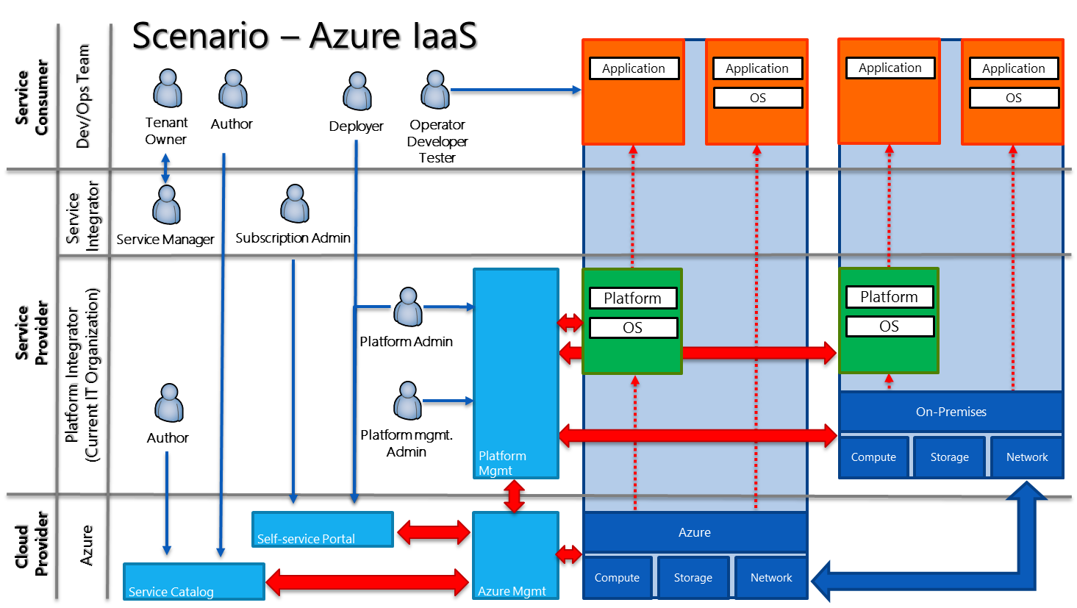
Cloud OS Roles
Notes:
For the Operations Guidance we will be focusing on the Fabric Roles, in the Orange box

Slide 11
Microsoft Azure Incident Workflow
Azure Global Support Team
Includes Local Language and Specialized Knowledge Teams
Azure Customer
Azure Subscription Mgmt. Support
Engage Route¹
Azure Portal
Incidents related to billing and subscriptions including the Commerce Platform.
Microsoft
Commerce Teams
Incidents related to Azure commerce business or the billing system:
Microsoft Operations
PayOps
Azure Business Desk
Commerce Platform Ops (CTP)
Account Research Team (ART)
Commerce Platform Engineering
Technical Support: Paid Support plan required.
Subscription Mgmt. Support: Free
MSDN, TechNet or MPN subscribers log on through a separate menu in the portal
Sub. Mgmt. volume is 70% of total Azure Support volume
Azure Technical Support
Incident Mgmt. System (MSSOLVE)
Azure Incident Closed
Premier Customer Service
Incidents related to specific to core Azure components, e.g., Virtual Machines.
Premier Customer
Specialized Knowledge Teams
The Customer may call Premier Support or submit a support request through MPO.
Incidents related to specific technologies: SQL, SharePoint, Platforms, Developer, Active Directory, Windows on Azure
Engage¹
Azure Engineering Component Teams & Operations
Premier Portal
Technical Support Volume is 30% of total Azure Support volume
Premier Rapid Response Customer
Premier add-on that provides <15 min guaranteed response time.
Azure Premier Rapid Response
Rapid Response team pulls in resources as needed for the specific case.
¹ “Route” passes ownership; “engage” obtains collaboration, but does not change the case ownership. Technical support engages with Operations or Engineering as needed.
Note: Initial support time varies from 15 min. to 8 hours depending on support plan.

Slide 12





Guiding your customer to the right support option
Scenario
Offering
Access Through
Description
Fastest Response Time¹
“I need help with my invoice.”
Free Support
Azure Portal
Select “Billing”
Billing Support
<2 Hrs²
“I want to change from my pay-as-you-go subscription to an EA subscription. How do I do that?”
Free Support
Azure Portal
Select “Billing”
Subscription Management Support
<2 Hrs²
“I want to increase my quota.”
Free Support
Azure Portal
Select “Billing”
Subscription Management Support
<2 Hrs²
“I have a generic technical question. Are there any self-help resources?”
Free Support
MSDN
Stack Overflow
MSDN and Stack Overflow self-help forums
no SLA³
n/a
“I’m developing applications running on Azure. I need access to technical expertise.”
Developer Support
$29/month
Select “Technical”
For non-production environments
Severity C only
Unlimited Break-fix
Azure Portal
No call-back
<8 Hrs
“Azure supports functions of my small business that are important but not critical. Which is the recommended support option for us?”
Standard Support
$300/month
Select “Technical”
SMB customers with a reactive support approach
All Severities
Call-backs/month<3
Azure Portal
Unlimited Break-fix
<2 Hrs
“Our medium size business is seeking support that goes beyond the traditional support hotline experience.”
Professional Direct Support
$1,000/month
Select “Technical”
Medium Business/Enterprise customer with a proactive support approach
Pooled Escalation Team
All Severities
Azure Portal
Advisory Services
Unlimited Break-fix
<1 Hr
“We are a large Enterprise customer looking for ongoing, proactive support of our Azure deployments.”
Premier Support
contact Services Sales
Call Premier or Use MPO
Enterprise Customer with a proactive support and high Azure Volume
Proactive Services for hybrid solutions
Cloud Operations Management
MPO
All Severities
Unlimited problem resolution
<1 Hr
“We need a support team that knows our business critical environment and is able to respond to our needs fast.”
Premier Support
Rapid Response Add-On
Use MPO
For mission or business critical environments
15 minute response time
Accelerated access to dedicated team
<15 Min
MPO
Team knows customer and environment
1 Response time depends on severity level; 2 If paid support plan in place, response time is informed by the respective plan; 3 No defined response time

Slide 13

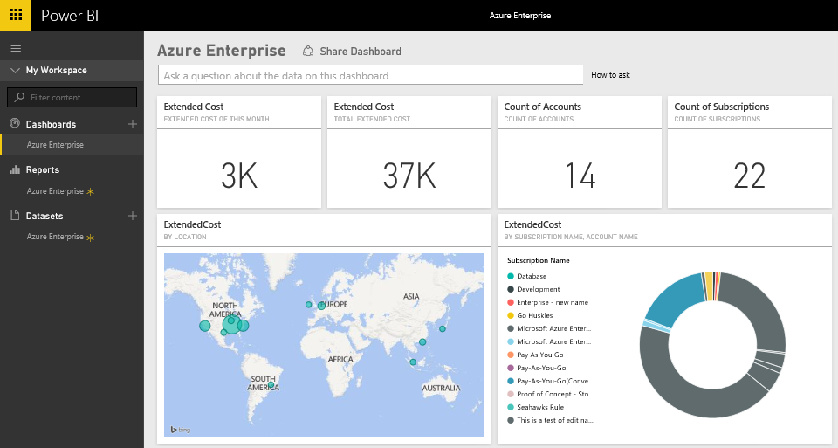
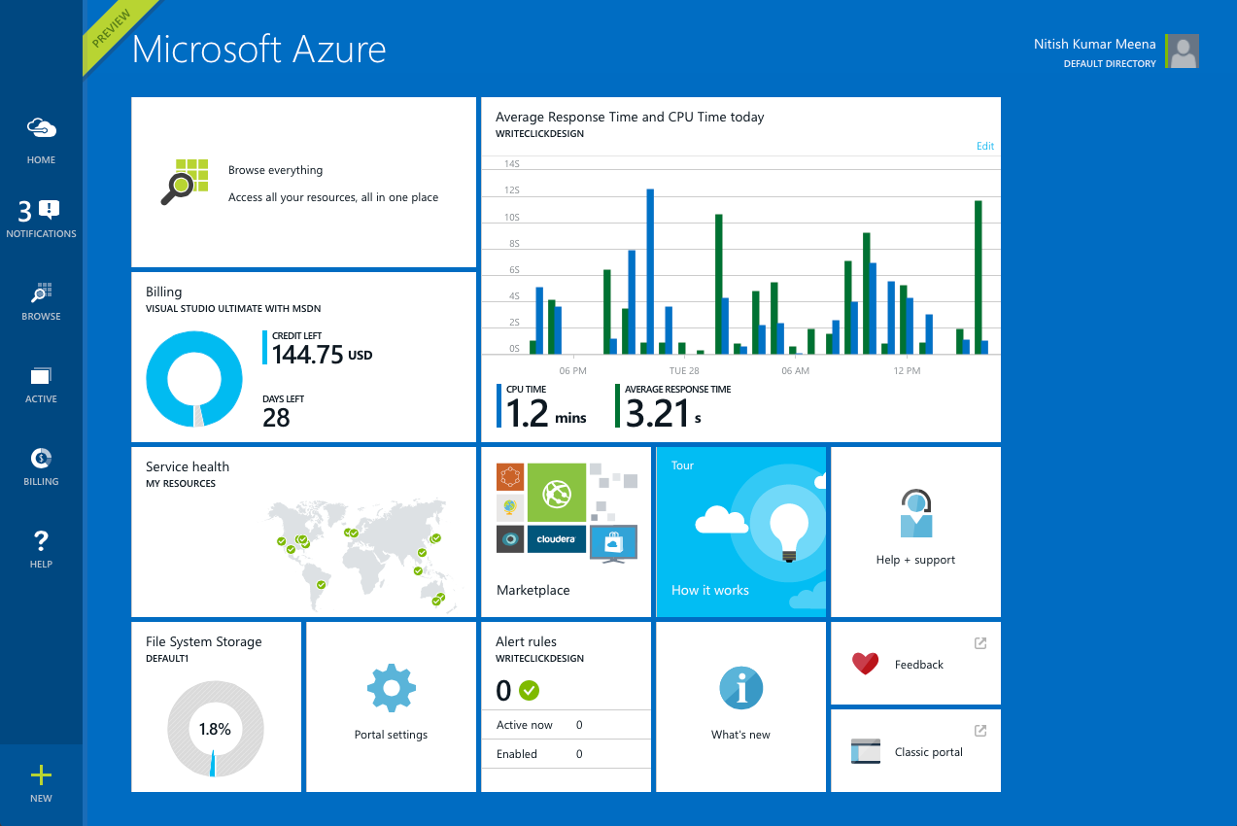
Billing PowerBI
Microsoft Azure Enterprise content pack for Power BI
Explore and monitor your Microsoft Azure Enterprise data in Power BI with the Power BI content pack
The data will be refreshed automatically once per day

Slide 14
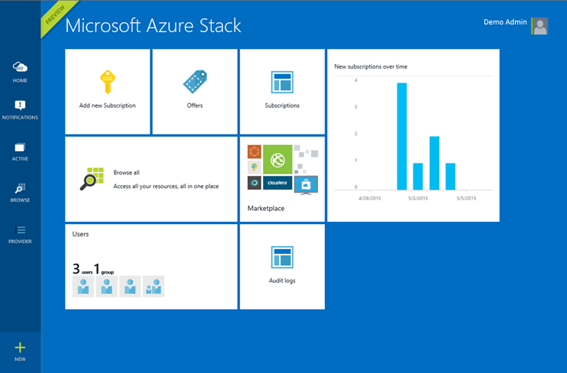
Azure Stack management portal
Cloud-consistent service delivery
Enable application owners and end-users productively consume software-defined infrastructure using the same intuitive self-service experience as Azure

Slide 15
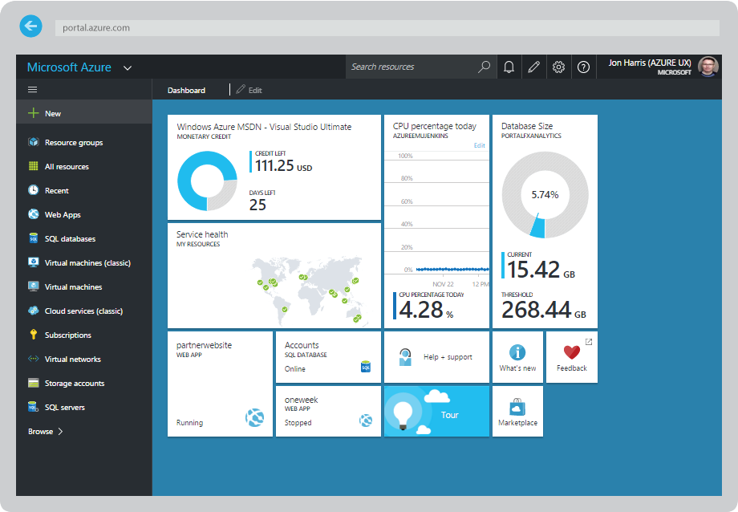
Azure management portal
Cloud-consistent service delivery
Enable application owners and end-users to productively consume software-defined infrastructure using the same intuitive self-service experience as Azure

Slide 16
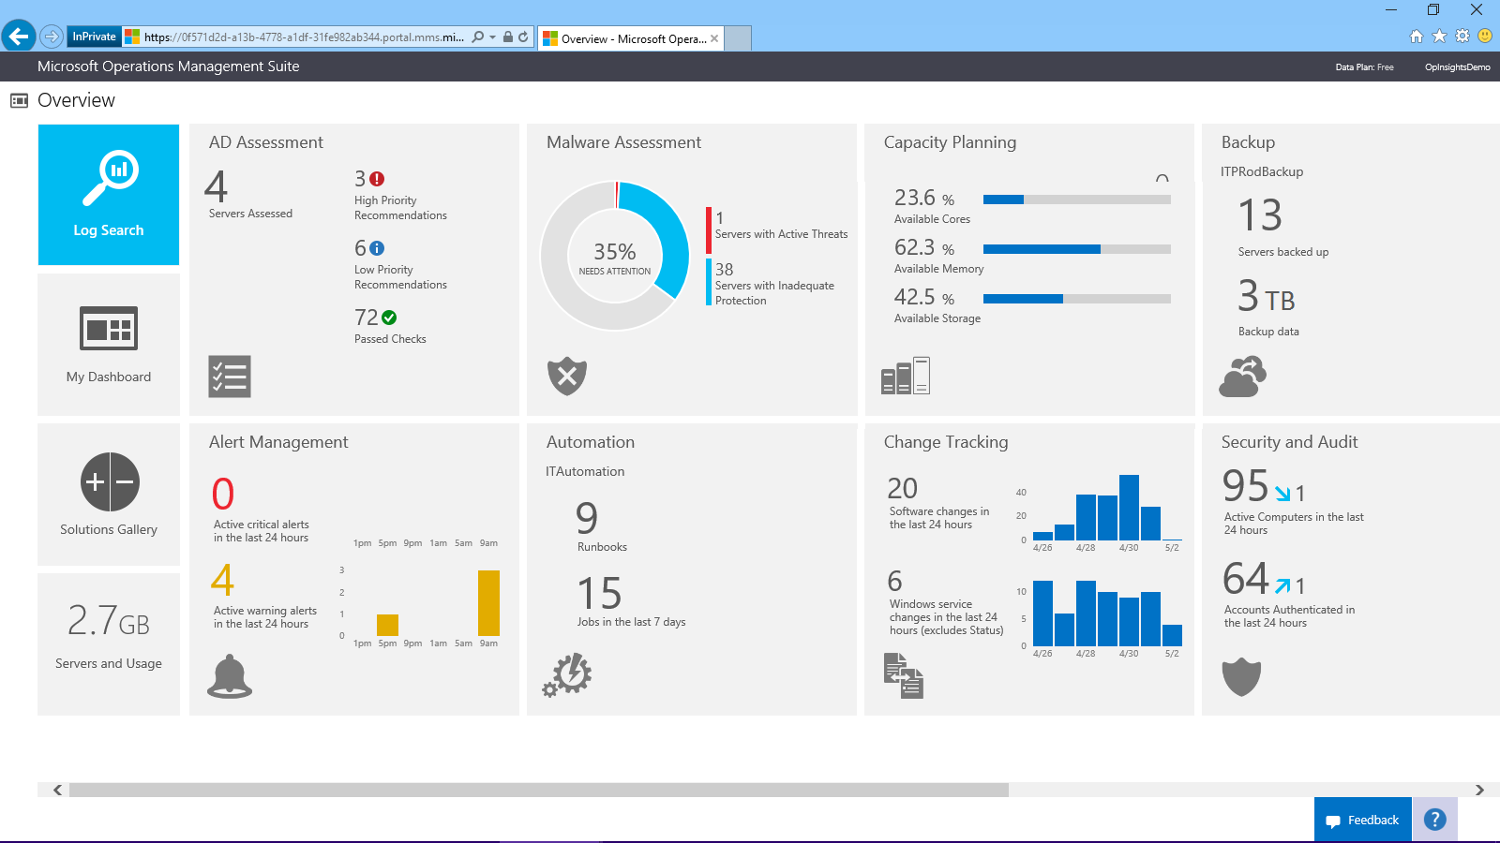
Operations Management Suite
SaaS management offering that works with any cloud
A single portal for all your management tasks. No infrastructure to maintain
Manage workloads across Windows and Linux, hybrid and public clouds, Azure and AWS
Complements your System Center investment to unleash new management scenarios

Slide 17










Un gran agradecimiento a los patrocinadores globales!

Slide 18

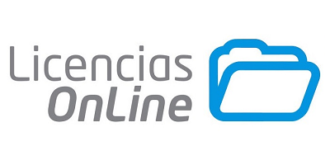

Un gran agradecimiento a los patrocinadores locales!

Slide 19


Gracias

